Slide 1
Week 5 Array and Vector part 1
CS 331
An introduction to C++ and Object-Oriented Programming
MD Romael Haque

Slide 2
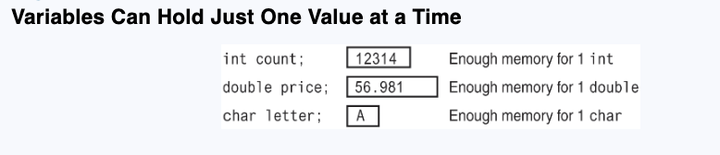
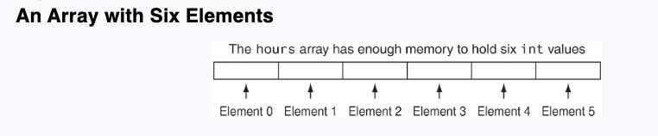
Arrays Hold Multiple Values
An array allows you to store and work with multiple values of the same data type.
An array works like a variable that can store a group of values, all of the same type. The values are stored together in consecutive memory locations. Here is a definition of an array of integers:
int hours[6];

Slide 3

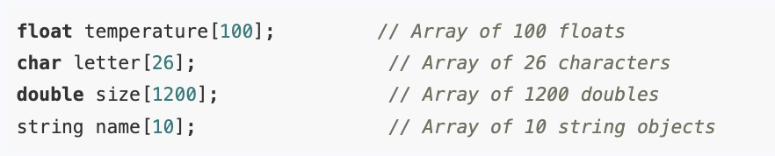
Arrays Hold Multiple Values
An array’s size declarator must be a constant integer expression with a value greater than zero. It can be either a literal, as in the previous example, or a named constant
Arrays of any data type can be defined. The following are all valid array definitions:

Slide 4
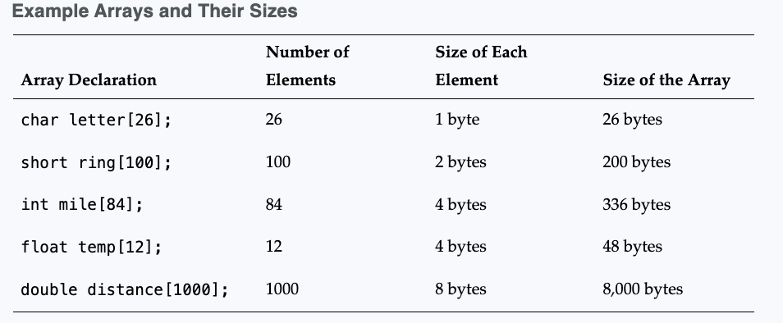
Memory Requirements of Arrays
The amount of memory used by an array depends on the array’s data type and the number of elements.
The size of an array can be calculated by multiplying the number of bytes needed to store an individual element by the number of elements in the array.

Slide 5
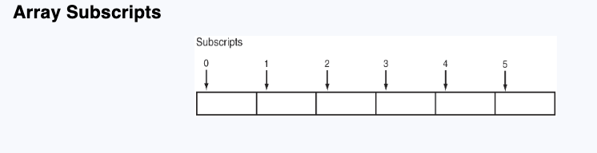
Accessing Array Elements
Even though an entire array has only one name, the elements may be accessed and used as individual variables.
This is possible because each element is assigned a number known as a subscript.
A subscript is used as an index to pinpoint a specific element within an array.

Slide 6
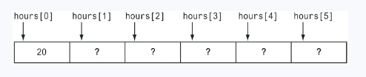
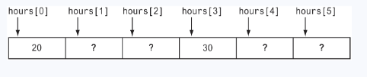
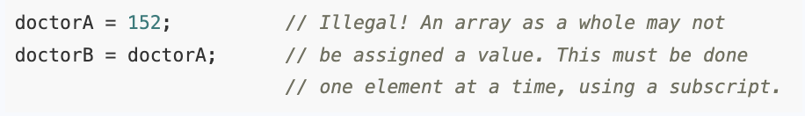
Accessing Array Elements
hours[0] = 20;
hours[3]=30;
Array elements may receive values with assignment statements just like other variables. However, entire arrays may not receive values for all their elements at once.

Slide 7
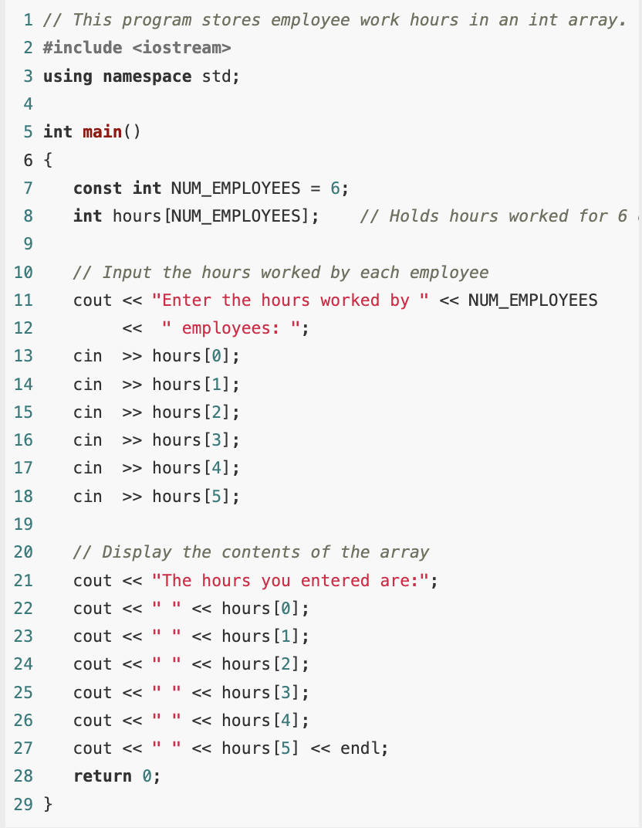

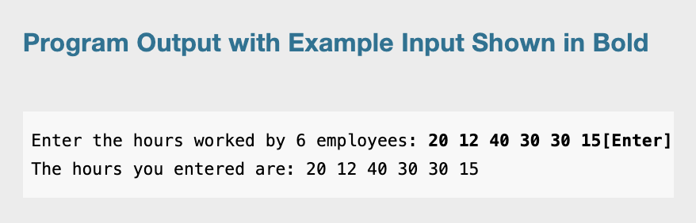
Inputting and Displaying Array Data

Slide 8
Inputting and Displaying Array Data
Even though most C++ compilers require the size declarator of an array definition to be a constant or a literal, subscript numbers can be stored in variables. This makes it possible to use a loop to “cycle through” an entire array, performing the same operation on each element.
Example: Store and display the hours worked by the employee but use loop to perform both operations.

Slide 9
No Bounds Checking in C++
One of the reasons for C++’s popularity has been the freedom it gives programmers to work with the computer’s memory.
This means that many of the safeguards provided by other languages to prevent programs from unsafely accessing memory are absent in C++
For example, C++ does not perform array bounds checking. This means you could write a program that accidentally allows an array’s subscript to go beyond its boundaries.

Slide 10
No Bounds Checking in C++
If the program tried to read in all the items in a file that contained more items than the array could hold, it could cause serious problems.
What exactly occurs depends on how your system manages memory.
On many systems it causes other nearby variables to have their contents overwritten, losing their correct value. On some systems it can even cause the computer to crash.

Slide 11
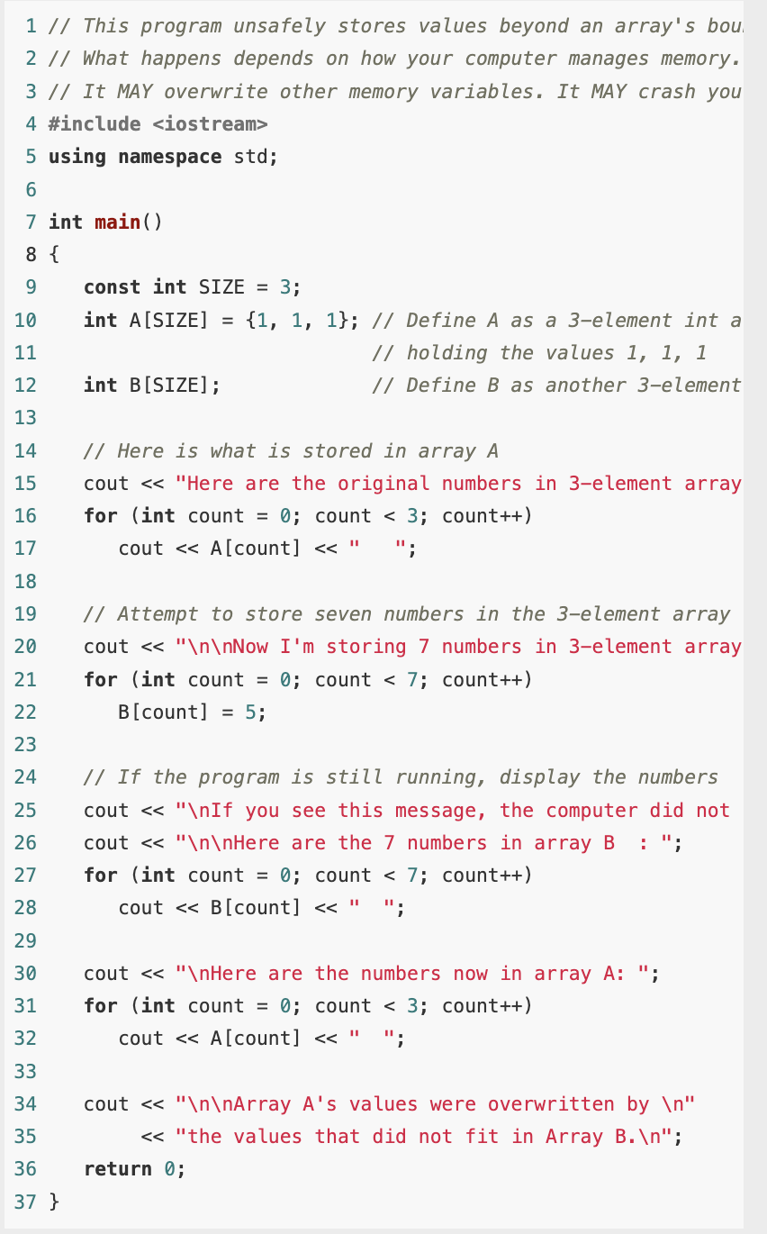
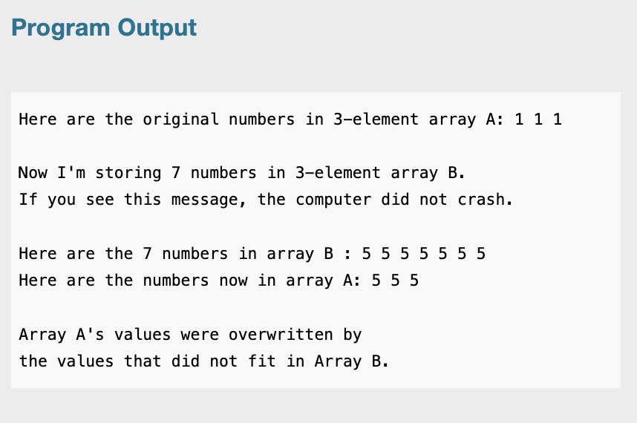
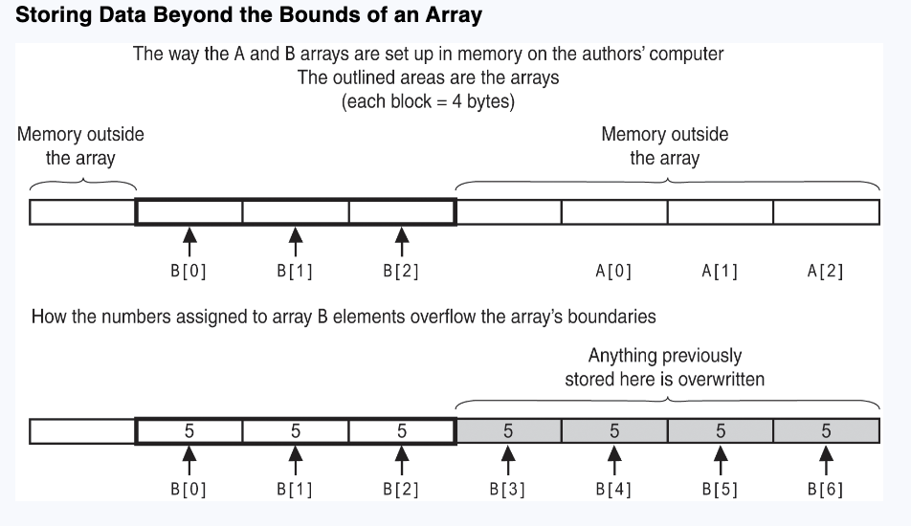
No Bounds Checking in C++

Slide 12
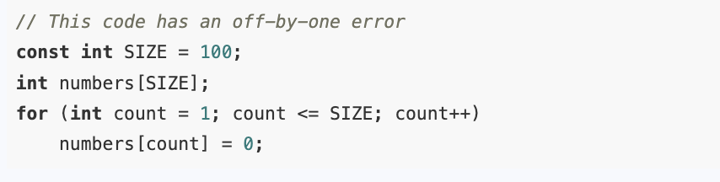
Watch for Off-By-One Errors
When working with arrays, a common type of mistake is the off-by-one error. This is an easy mistake to make because array subscripts start at 0 rather than 1.

Slide 13
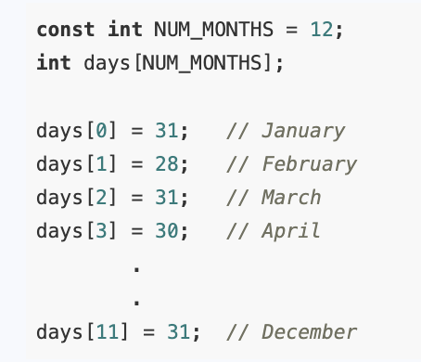
Array Initialization
Arrays may be initialized when they are defined.
Sometimes it is more appropriate to set variable values within a program than to input them.
However, writing separate assignment statements for the individual elements of an array can mean a lot of typing, especially for large arrays.

Slide 14
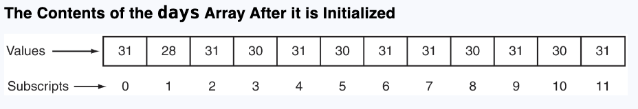
Array Initialization
Solution:
int days[NUM_MONTHS] = {31, 28, 31, 30, 31, 30, 31, 31, 30, 31, 30, 31};

Slide 15
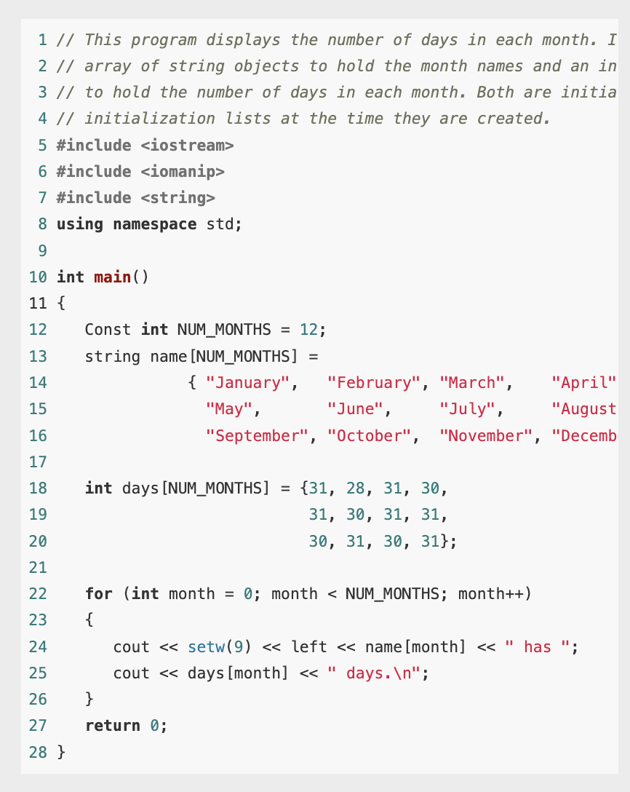
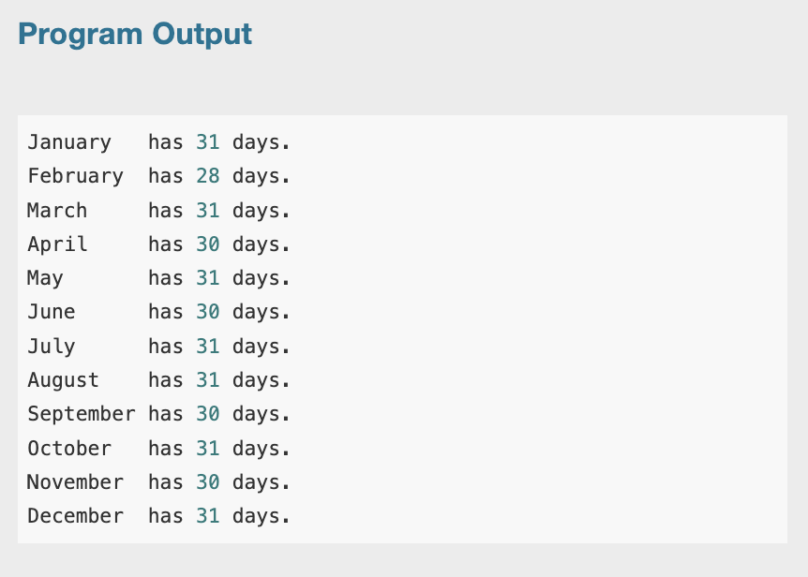
Array Initialization: Example

Slide 16
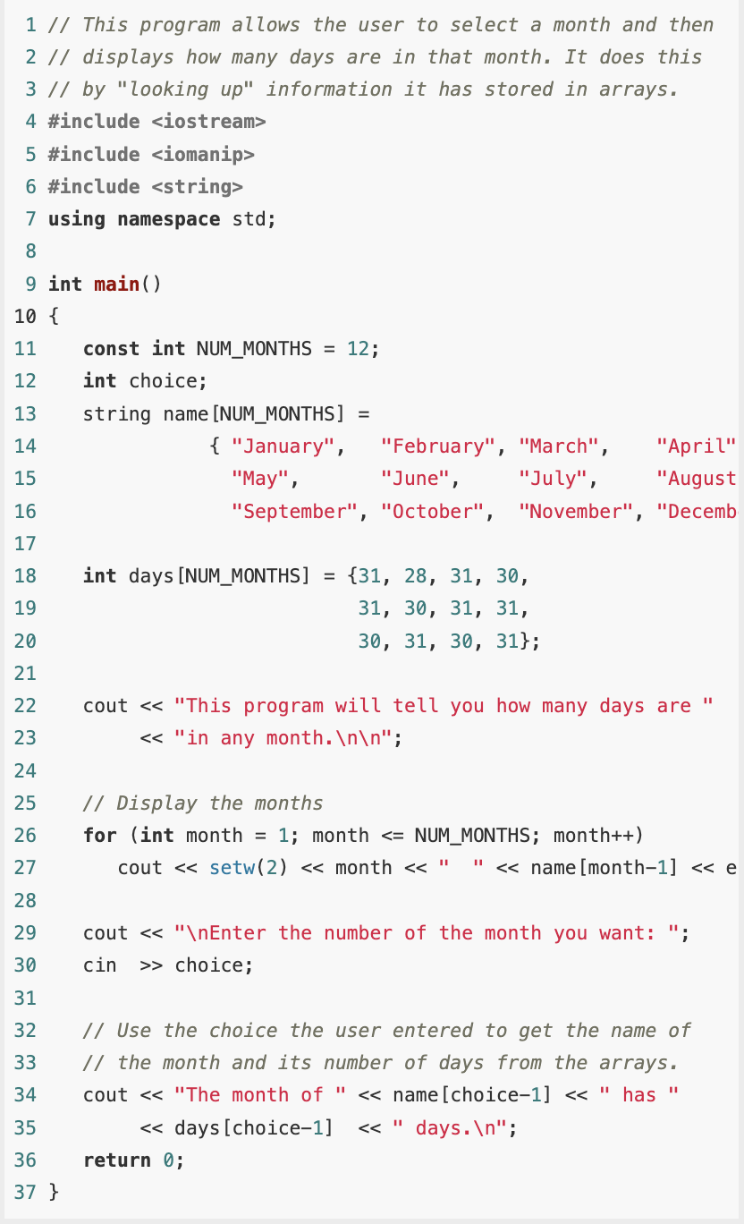
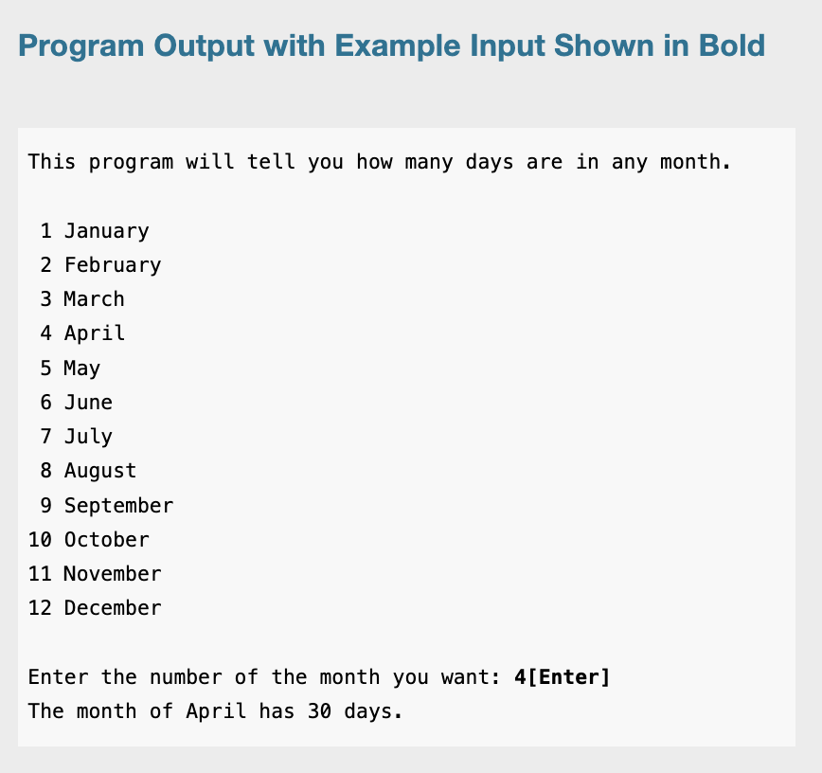
Array Initialization: Example

Slide 17
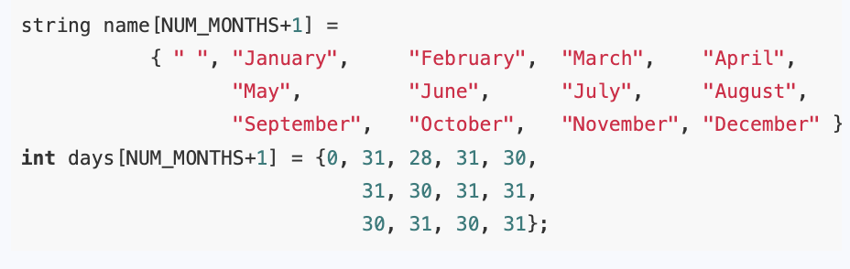
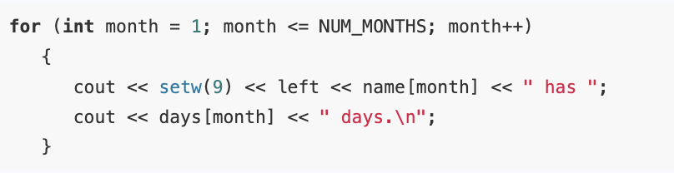
Starting with Array Element 1
Some instructors prefer that you not use array element 0 and, instead, begin storing the actual data in element 1 when you are modeling something in the real world that logically begins with 1. The months of the year are a good example.

Slide 18
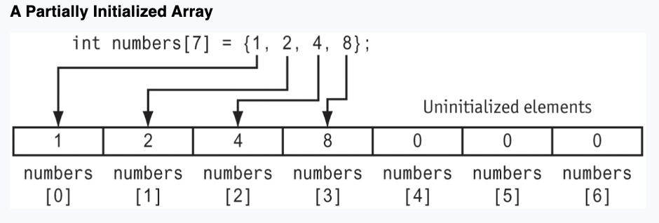
Partial Array Initialization
When an array is being initialized, C++ does not require a value for every element. It’s possible to only initialize part of an array, like this: int numbers[7] = {1, 2, 4, 8};
int numbers[7] = {1, 2, 4, 8, 3, 5, 7, 9}; // NOT legal! 8 values
int numbers[7] = {1, , 4, , 3, 5, 7}; // NOT legal! Can’t skip

Slide 19
Implicit Array Sizing
You can define an array without specifying its size by providing an initialization list that includes a value for every element. C++ counts the number of items in the initialization list and gives the array that many elements.
double ratings[] = {1.0, 1.5, 2.0, 2.5, 3.0};
You must specify an initialization list if you leave out the size declarator. Otherwise, C++ doesn’t know how large to make the array.

Slide 20
The Range-Based for Loop
The range-based for loop is a loop that iterates once for each element in an array.
Each time the loop iterates, it copies an element from the array to a variable.
When you use the range-based for loop with an array, the loop automatically iterates once for each element in the array.
For example, if you use the range-based for loop with an eight-element array, the loop will iterate eight times. Because the range-based for loop automatically knows the number of elements in an array, you do not have to use a counter variable to control its iterations or have to worry about stepping outside the bounds of the array.

Slide 21

The Range-Based for Loop
Here is the general format of the range-based for loop:
The range-based for loop works with a built-in variable known as the range variable.
Each time the range-based for loop iterates, it copies the next array element to the range variable.

Slide 22
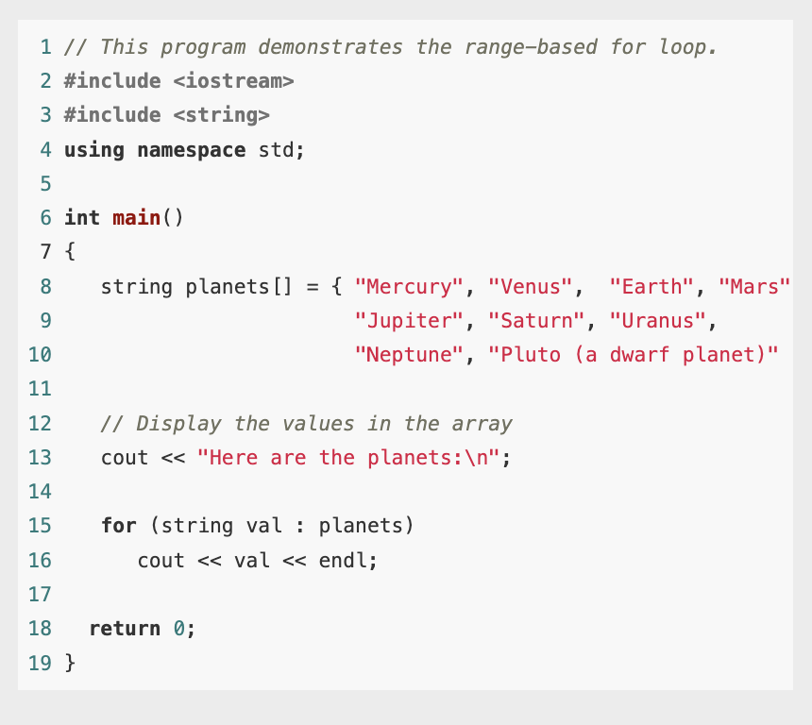
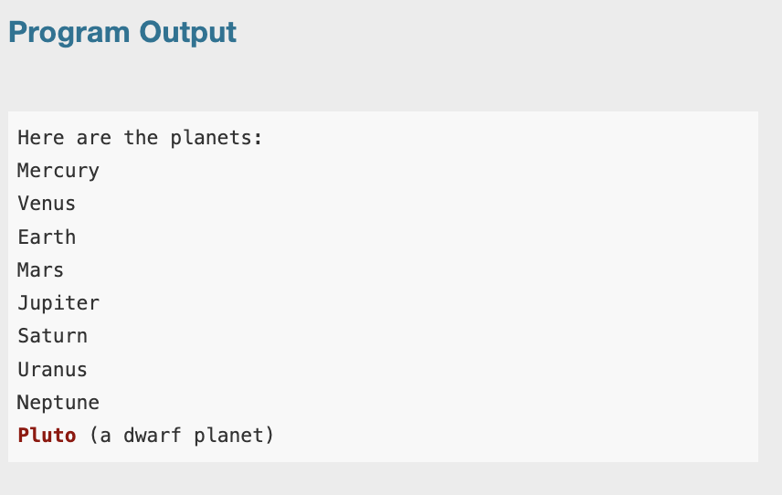
The Range-Based for Loop: Example

Slide 23
Modifying an Array with a Range-Based for Loop
As the range-based for loop executes, its range variable contains only a copy of an array element.
As a consequence, you cannot use a range-based for loop to modify the contents of an array unless you declare the range variable as a reference.
A reference variable is an alias for another value. Any changes made to the reference variable are actually made to the value for which it is an alias.
To declare the range variable as a reference variable, place an ampersand (&) in front of its name in the loop header.

Slide 24
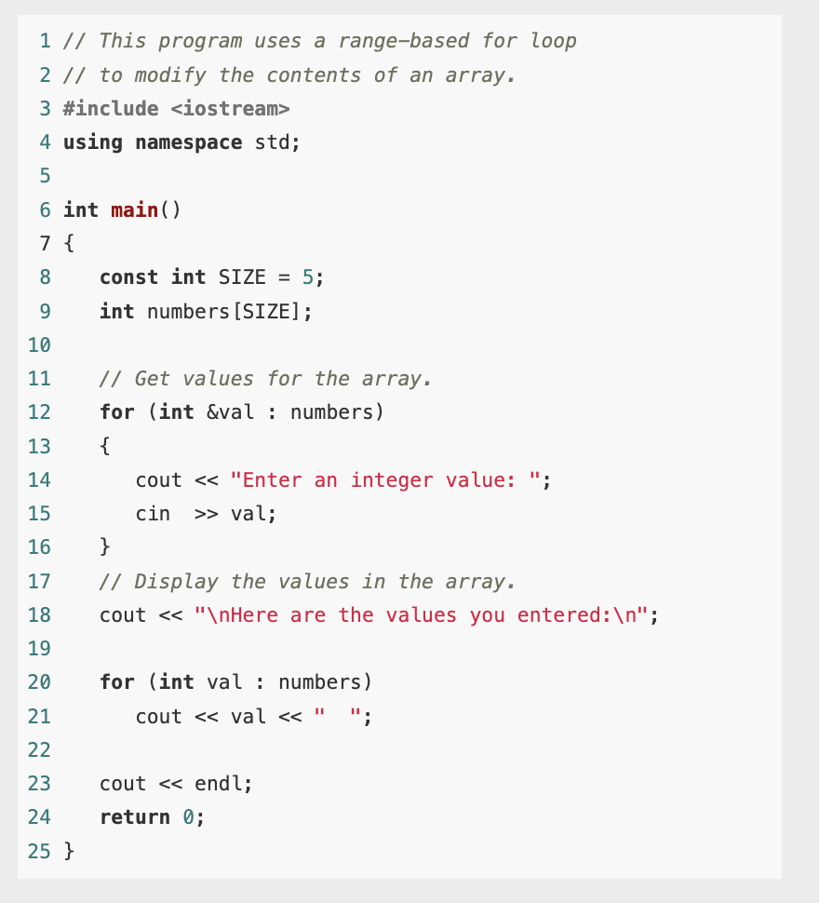
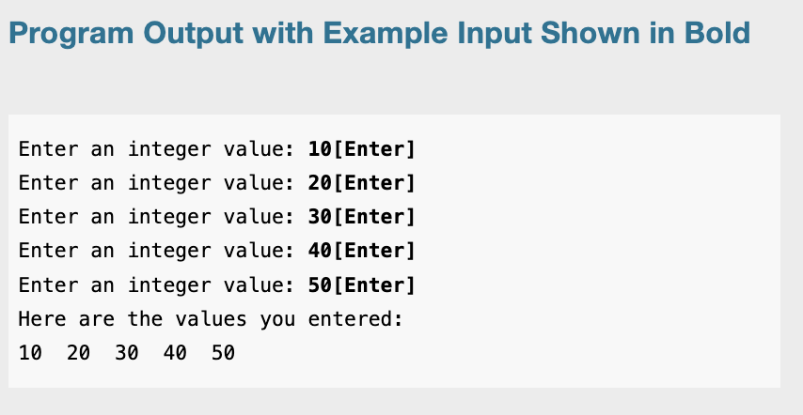
Modifying an Array with a Range-Based for Loop

Slide 25
The Range-Based for Loop versus the Regular for Loop
The range-based for loop can be used in any situation where you need to step through all the elements of an array, and you do not need to use the element subscripts.
It will not work, however, in situations where you need the element subscript for some purpose.
It will also not work if the loop control variable is being used to access elements of two or more different arrays.
In these situations, you need to use the regular for loop.

